Slide 1
Implementing distributed transactions
Using .NET Core and MassTransit
Steliyan
Software Craftsman at ST6, LTD
e: steliyan@st6.io w: https://st6.io

Slide 2
WHAT’S A TRANSACTION
Definition: Transaction processing is information processing in computer science that is divided into individual, indivisible operations called transactions. Each transaction must succeed or fail as a complete unit; it can never be only partially complete.

Slide 3
WHAT’S A DISTRIBUTED TRANSACTION
Definition: A distributed transaction is a type of transaction with two or more engaged network hosts. Generally, hosts provide resources, and a transaction manager is responsible for developing and handling the transaction.

Slide 4
OUR GOAL
Execute a sequence of activities that complete entirely, or not at all.

Slide 5
USING A MESSAGE BROKER
Loose coupling
Queue data for later delivery/processing
Async processing
Load balancing

Slide 6
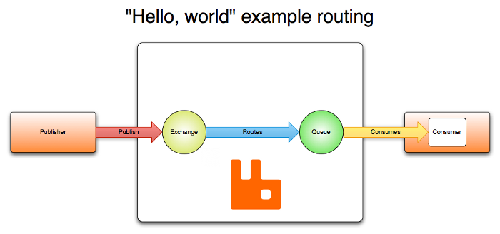
ENTER RABBITMQ

Slide 7
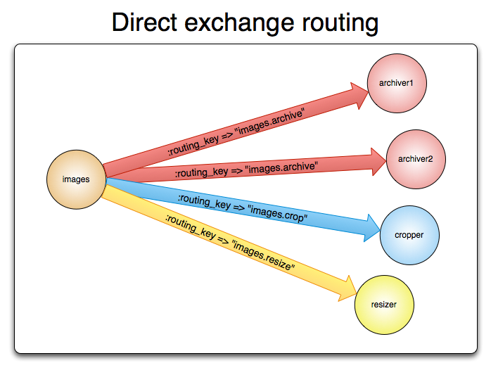
DIRECT EXCHANGE
Used for distributing tasks between multiple workers.

Slide 8
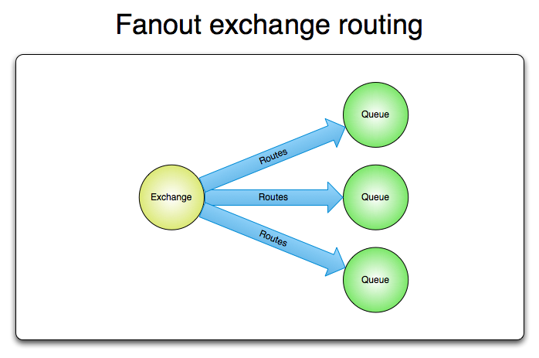
FANOUT EXCHANGE
Used for distributing various state/configuration updates.

Slide 9
NON-COVID 19 ANALOGY
Queue is like your destination in New York city.
Exchange is like JFK airport.
Bindings are routes from JFK to your destination. There can be zero or many ways to reach it.

Slide 10
ENTER MASSTRANSIT
MassTransit is a free, open-source distributed application framework for .NET. MassTransit makes it easy to create applications and services that leverage message-based, loosely-coupled asynchronous communication for higher availability, reliability, and scalability.

Slide 11
HIGHLIGHTS OF MASSTRANSIT
Transport Liquidity
Deploy your solution using RabbitMQ, Azure Service Bus, ActiveMQ, and Amazon SQS/SNS without having to rewrite it.
Powerful Message Patterns
Including message consumers, persistent sagas and event-driven state machines, and routing-slip based distributed transactions with compensation.

Slide 12
HIGHLIGHTS OF MASSTRANSIT
End-to-End Solution
Handles message serialization, headers, broker topology, message routing, exceptions, retries, concurrency, connection and consumer lifecycle management.
Unit Testable
In memory test harness for creating fast unit tests with comprehensive integration test level verification.

Slide 13
DEMO

Slide 14
BUSINESS TRANSACTION
A sequence of business activities that are performed to complete an operation.
Some activities are harmless.
Look up member address, verify membership
Some activities have consequences.
Charge payments, allocate seats, provision materials.

Slide 15
REACHING CONSISTENCY
Immediate consistency in business is rare.
Records become consistent over time.
Time may be seconds, days, even months.
Eventual consistency is the natural order of business.
Local consistency is key to user acceptance.

Slide 16
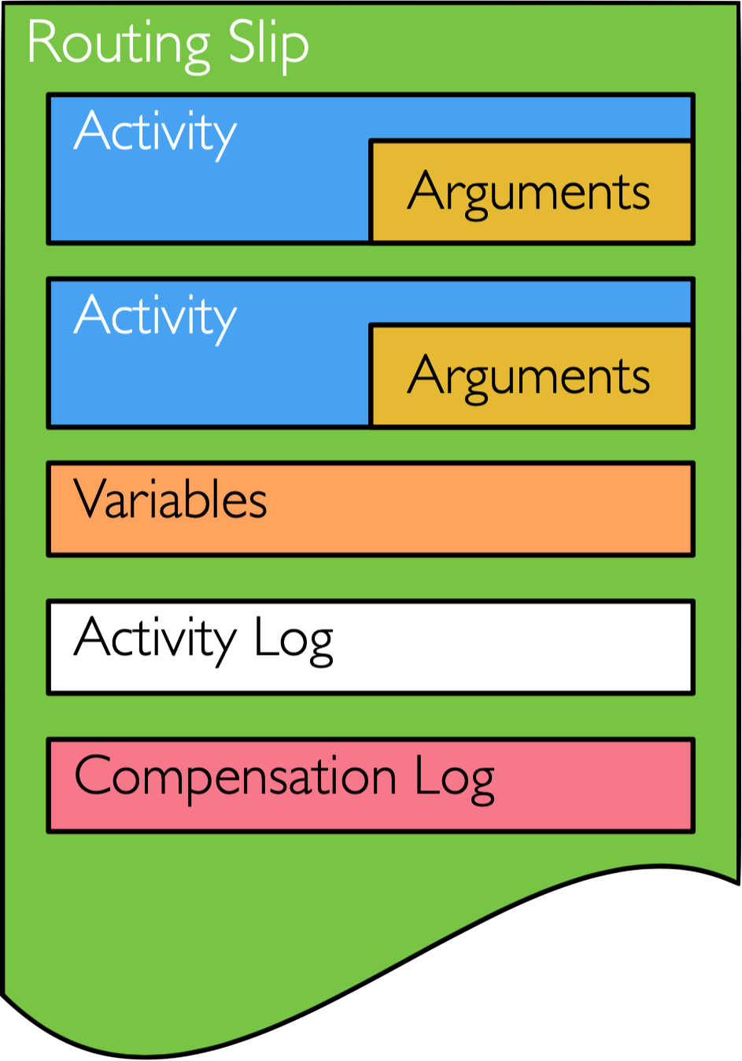
ROUTING SLIP PATTERN
The analogy to a paper routing slip is both obvious and intentional

Slide 17
DEMO

